Slide 1
Chapter: 3
Matrices & Determinants

Slide 2
Session Objectives
Meaning of matrix
Type of matrices
Transpose of Matrix
Meaning of symmetric and skew symmetric matrices
Minor & co-factors
Computation of adjoint and inverse of a matrix

Slide 3
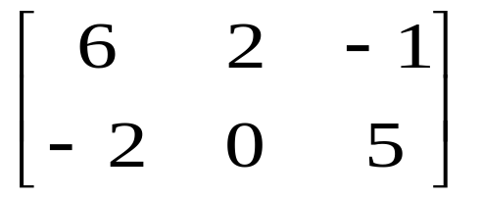
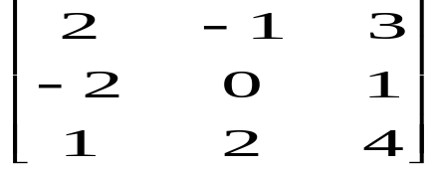
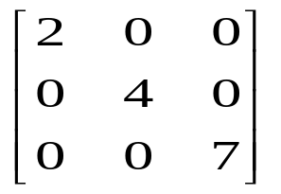
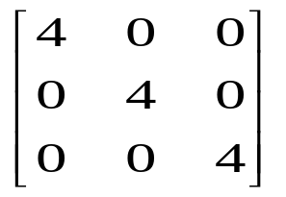
TYPES OF MATRICES
NAME | DESCRIPTION | EXAMPLE
Rectangular matrix | No. of rows is not equal to no. of columns
Square matrix | No. of rows is equal to no. of columns
Diagonal matrix | Non-zero element in principal diagonal and zero in all other positions
Scalar matrix | Diagonal matrix in which all the elements on principal diagonal and same

Slide 4
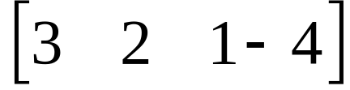

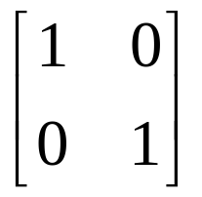
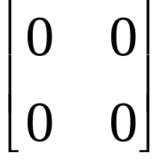
TYPES OF MATRICES
NAME | DESCRIPTION | EXAMPLE
Row matrix | A matrix with only 1 row
Column matrix | A matrix with only I column
Identity matrix | Diagonal matrix having each diagonal element equal to one (I)
Zero matrix | A matrix with all zero entries

Slide 5
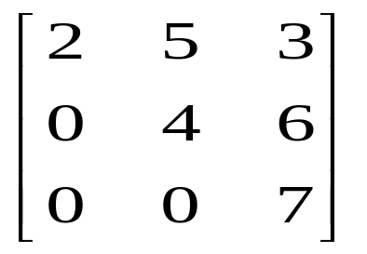
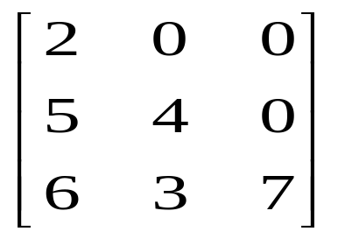
TYPES OF MATRICES
NAME | DESCRIPTION | EXAMPLE
Upper Triangular matrix | Square matrix having all the entries zero below the principal diagonal
Lower Triangular matrix | Square matrix having all the entries zero above the principal diagonal

Slide 6
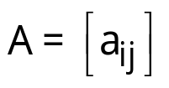
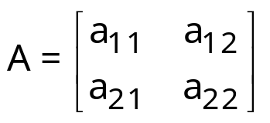
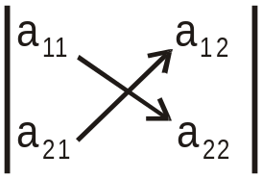
Determinants
If is a square matrix of order 1,
then |A| = | a₁₁ | = a₁₁
If is a square matrix of order 2, then
|A| = = a₁₁a₂₂ – a₂₁a₁₂

Slide 7
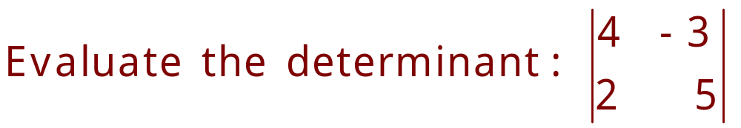
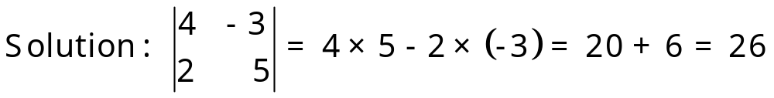
Example

Slide 8
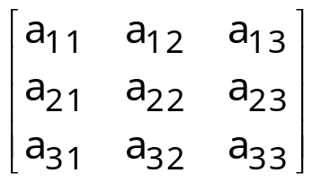
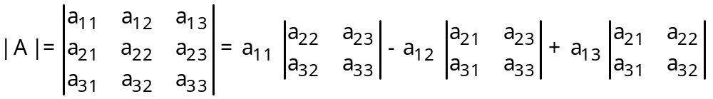
Solution
If A = is a square matrix of order 3, then
[Expanding along first row]

Slide 9
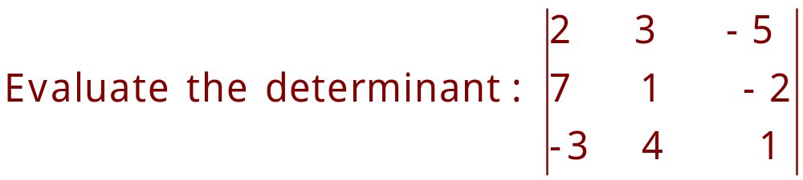
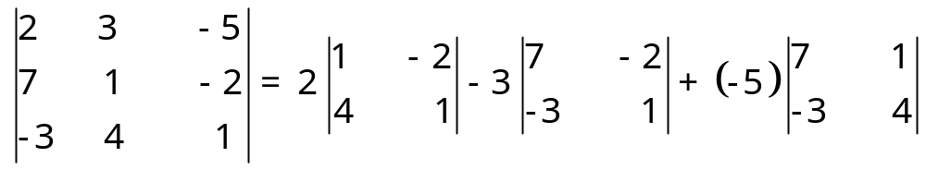
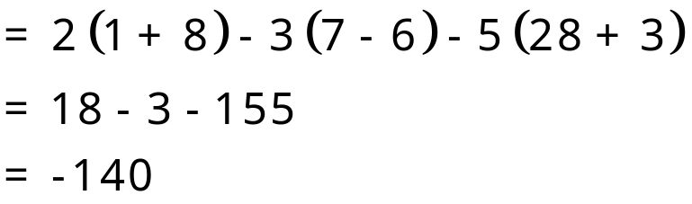
Example
Solution :
[Expanding along first row]

Slide 10
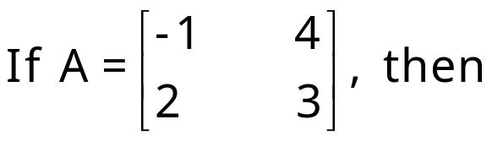
Minors

Slide 11
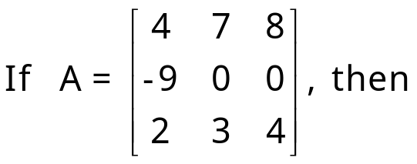
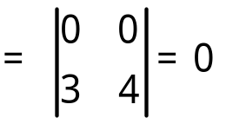
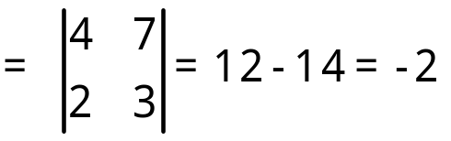
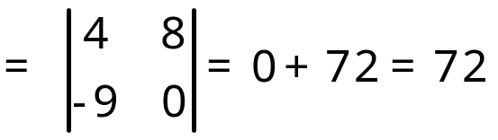
Minors
M₁₁ = Minor of a₁₁ = determinant of the order 2 × 2 square
sub-matrix is obtained by leaving first
row and first column of A
Similarly, M₂₃ = Minor of a₂₃
M₃₂ = Minor of a₃₂ etc.

Slide 12
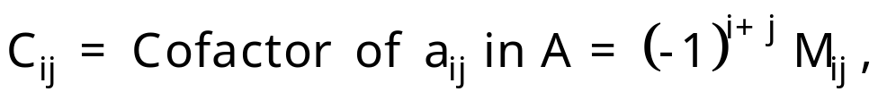

Cofactors

Slide 13
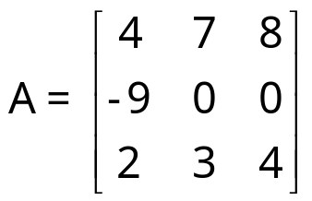
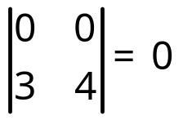
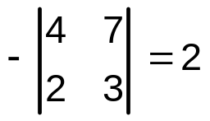
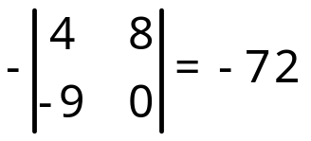
Cofactors (Con.)
C₁₁ = Cofactor of a₁₁ = (–1)¹ ⁺ ¹ M₁₁ = (–1)¹ ⁺¹
C₂₃ = Cofactor of a₂₃ = (–1)² ⁺ ³ M₂₃ =
C₃₂ = Cofactor of a₃₂ = (–1)³ ⁺ ²M₃₂ = etc.

Slide 14
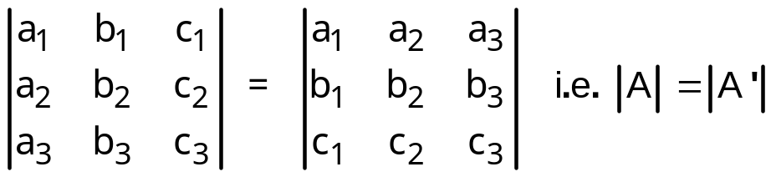
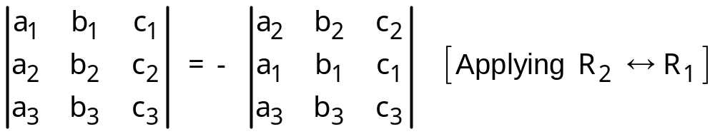
Properties of Determinants
1. The value of a determinant remains unchanged, if its rows and columns are interchanged.
2. If any two rows (or columns) of a determinant are interchanged, then the value of the determinant is changed by minus sign.

Slide 15
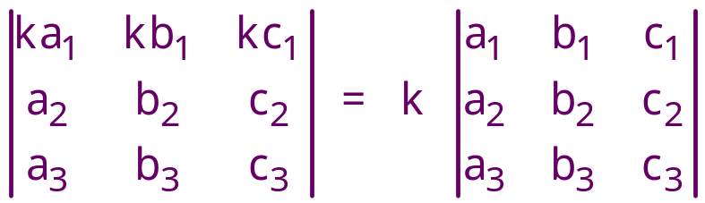
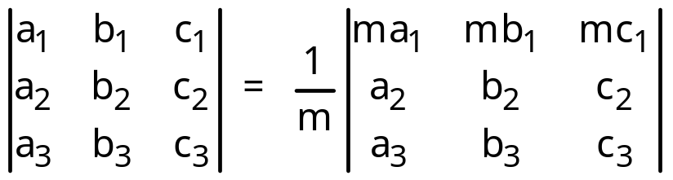
Properties (Con.)
3. If all the elements of a row (or column) is multiplied by a non-zero number k, then the value of the new determinant is k times the value of the original determinant.
which also implies

Slide 16
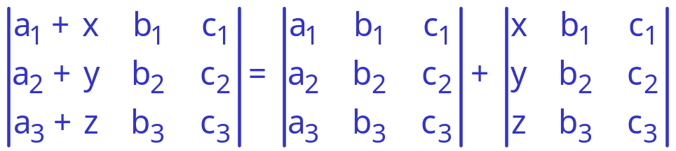
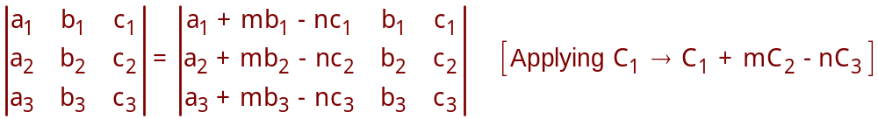
Properties (Con.)
4. If each element of any row (or column) consists of two or more terms, then the determinant can be expressed as the sum of two or more determinants.
5. The value of a determinant is unchanged, if any row (or column) is multiplied by a number and then added to any other row (or column).

Slide 17
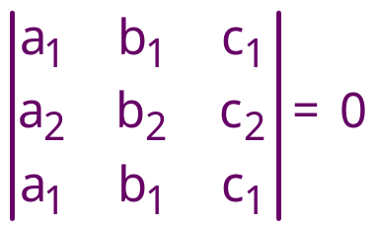
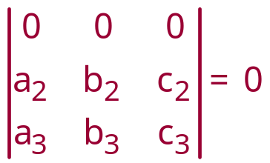
Properties (Con.)
6. If any two rows (or columns) of a determinant are identical, then its value is zero.
If each element of a row (or column) of a determinant is zero,
then its value is zero.

Slide 18
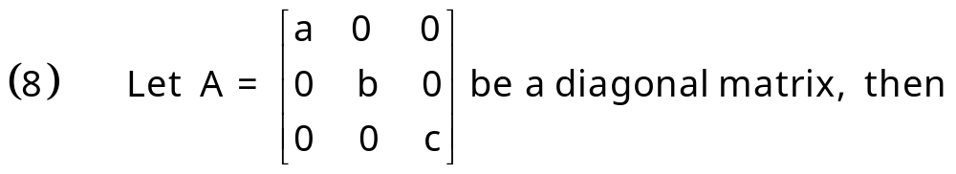
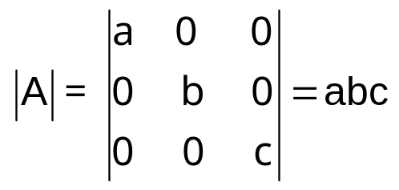
Properties (Con.)

Slide 19

Row(Column) Operations
Following are the notations to evaluate a determinant:
(i) R_{i} to denote ith row
(ii) R_{i} R_{j} to denote the interchange of ith and jth rows.
(iii) R_{i} R_{i} + λR_{j} to denote the addition of λ times the elements of jth row to the corresponding elements of ith row.
(iv) λR_{i} to denote the multiplication of all elements of ith row by λ.
Similar notations can be used to denote column
operations by replacing R with C.
Notes:
If A is the determinant of order 2, then its value can be easily found. But to evaluate determinants of square matrices of higher orders, we should always try to introduce zeros at maximum number of places in a particular row (column) by using properties of determinant.

Slide 20

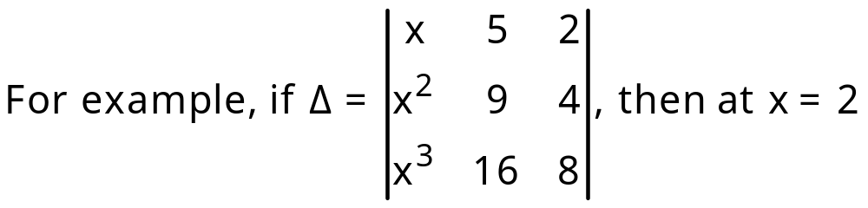


Evaluation of Determinants
If a determinant becomes zero on putting is the factor of the determinant.
, because C₁ and C₂ are identical at x = 2
Hence, (x – 2) is a factor of determinant .

Slide 21
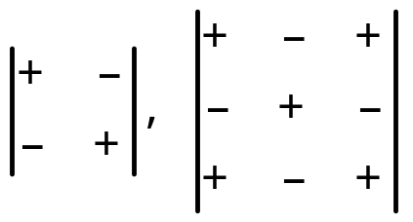
Sign System for Expansion of Determinant
Sign System for order 2 and order 3 are given by

Slide 22
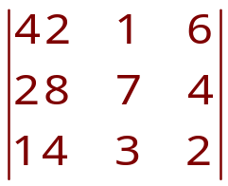
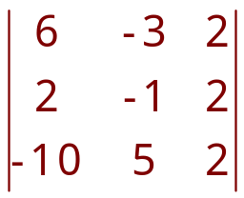
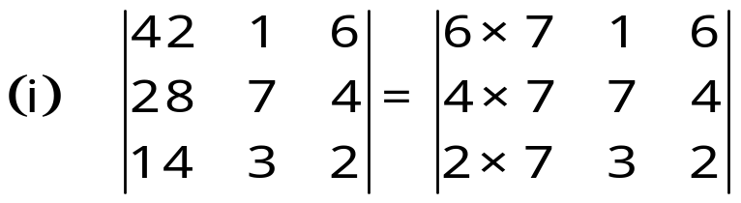
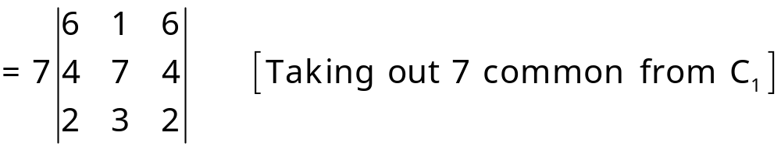
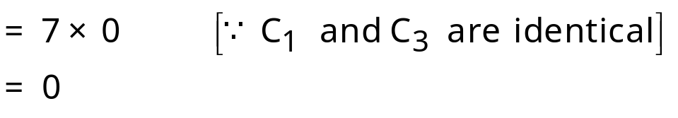
Example-1
Find the value of the following determinants
(i) (ii)
Solution :

Slide 23
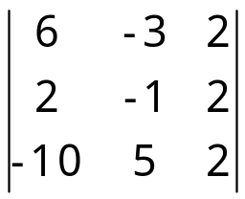
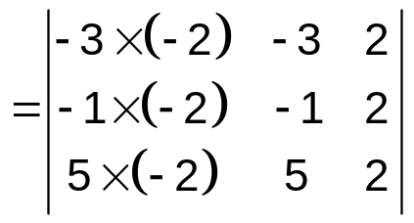
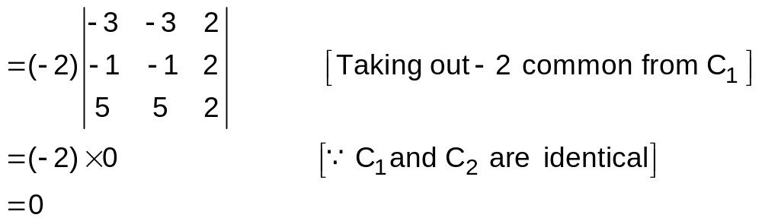
Example –1 (ii)
(ii)

Slide 24
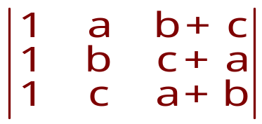



Example - 2
Evaluate the determinant
Solution :

Slide 25




Example - 3
Evaluate the determinant:
Solution:

Slide 26



Solution Cont.
Now expanding along C₁ , we get
(a-b) (b-c) (c-a) [- (c² – ab – ac – bc – c²)]
= (a-b) (b-c) (c-a) (ab + bc + ac)

Slide 27




Example-4
Without expanding the determinant,
prove that
Solution :

Slide 28




Solution Cont.

Slide 29



Example -5
Prove that : = 0 , where ω is cube root of unity.
Solution :

Slide 30



Example-6
Prove that :
Solution :

Slide 31

Solution cont.
Expanding along C₁ , we get
(x + a + b + c) [1(x²)] = x² (x + a + b + c)
= R.H.S

Slide 32




Example -7
Using properties of determinants, prove that
Solution :

Slide 33



Solution Cont.
Now expanding along R₁ , we get

Slide 34



Example - 8
Using properties of determinants prove that
Solution :

Slide 35



Solution Cont.
Now expanding along C₁ , we get

Slide 36



Example -9
Using properties of determinants, prove that
Solution :

Slide 37



Solution Cont.

Slide 38




Example -10
Show that
Solution :

Slide 39


Solution Cont.

Slide 40



Applications of Determinants (Area of a Triangle)
The area of a triangle whose vertices are
is given by the expression

Slide 41



Example
Find the area of a triangle whose vertices are (-1, 8), (-2, -3) and (3, 2).
Solution :

Slide 42

Condition of Collinearity of Three Points
If are three points,
then A, B, C are collinear

Slide 43



Example
If the points (x, -2) , (5, 2), (8, 8) are collinear, find x , using determinants.
Solution :
Since the given points are collinear.

Slide 44




Solution of System of 2 Linear Equations (Cramer’s Rule)
Let the system of linear equations be

Slide 45


Cramer’s Rule (Con.)
then the system is consistent and has unique solution.
then the system is consistent and has infinitely many solutions.
then the system is inconsistent and has no solution.

Slide 46




Example
Using Cramer's rule , solve the following system of equations 2x-3y=7, 3x+y=5
Solution :

Slide 47






Solution of System of 3 Linear Equations (Cramer’s Rule)
Let the system of linear equations be

Slide 48
Cramer’s Rule (Con.)
Note:
(1) If D ≠ 0, then the system is consistent and has a unique solution.
(2) If D=0 and D₁ = D₂ = D₃ = 0, then the system has infinite solutions or no solution.
(3) If D = 0 and one of D₁, D₂, D₃ ≠ 0, then the system
is inconsistent and has no solution.
If d₁ = d₂ = d₃ = 0, then the system is called the system of homogeneous linear equations.
If D ≠ 0, then the system has only trivial solution x = y = z = 0.
(ii) If D = 0, then the system has infinite solutions.

Slide 49



Example
Using Cramer's rule , solve the following system of equations
5x - y+ 4z = 5
2x + 3y+ 5z = 2
5x - 2y + 6z = -1
Solution :
= 5(18+10) + 1(12-25)+4(-4 -15)
= 140 –13 –76 =140 - 89
= 51
= 5(18+10)+1(12+5)+4(-4 +3)
= 140 +17 –4
= 153

Slide 50



Solution Cont.
= 5(12 +5)+5(12 - 25)+ 4(-2 - 10)
= 85 + 65 – 48 = 150 - 48
= 102
= 5(-3 +4)+1(-2 - 10)+5(-4-15)
= 5 – 12 – 95 = 5 - 107
= - 102

Slide 51

Example
Solve the following system of homogeneous linear equations:
x + y – z = 0, x – 2y + z = 0, 3x + 6y + -5z = 0
Solution:
Putting z = k, in first two equations, we get
x + y = k, x – 2y = -k

Slide 52



Solution (Con.)
These values of x, y and z = k satisfy (iii) equation.

Slide 53

Thank you

